Slide 1
Routing Information Protocol (RIP)

Slide 2

Repetition: Basic Routing
Our approach so far:
Next-hop routing
Logical (IP) addresses
Static Tables
This approach works only for small IP networks
We need to support dynamic large networks
N1, -
N2, R2
N3, R2 N4, R2
A
R1
R2
R3
B
N1
N4
R4
N2
N3
C
D
E
F

Slide 3
Reachability and Metrics
The most fundamental functionality in a dynamic routing protocol:
Find the ”best path” to a destination
Two algorithms in use to find best path
Distance-Vector (Bellman-Ford)
Link-state (Dijkstra)
But what is best path?
Interior routing: typically number of hops, or bandwidth
Exterior routing: business relations—peering
Metrics
Number of hops (most common)
Bandwidth, Delay, Cost, Load, ”Policies”

Slide 4
Popular Routing Protocols
Routing Protocols
Routing Protocols
Interior
Exterior
Interior
Exterior
RIP
OSPF
IGRP
(cisco)
IS-IS
BGP
EGP
RIP
OSPF
IGRP
(cisco)
IS-IS
BGP
EGP

Slide 5
Routing Information Protocol - RIP
RIP-1 (RFC 1058), RIP-2 (RFC 2453)
Metric is Hop Counts
1: directly connected
16: infinity
RIP cannot support networks with diameter > 15.
RIP uses distance vector
RIP messages contain a vector of hop counts.
Every node sends its routes to its neighbours
Route information gradially spreads through the network
Every node selects the route with smallest metric.
RIP messages are carried via UDP datagrams.
IP Multicast (RIP-2) or Broadcast (RIP-1)

Slide 6
Distance Vector
A node advertizes its “distance- vector”
3
a
b
A list (vector) of all nodes that the node knows about
The distance to each of them
1
1
2
c
2
Advertizements are sent to neighbours only
Each neighbour updates its routing table and sends the new distance-vectors to its neighbours
Bellman-Ford algorithm
4
e
d
1
{a, | 2} | {b, | 3} | {c, | 4} | {d, | 1} | {e, | 0}
Distance-vector from ”e”

Slide 7
Distance vector algorithm
Bellman-Ford equation (dynamic programming)
let
d_{x}(y) := cost of least-cost path from x to y
then
d_{x}(y) = min {c(x,v) + d_{v}(y) }
v
cost from neighbor v to destination y
cost to neighbor v
min taken over all neighbors v of x

Slide 8
Bellman-Ford example
5
clearly, d_{v}(z) = 5, d_{x}(z) = 3, d_{w}(z) = 3
v
3
w
2
5
u
z
B-F equation says:
2
1
3
1
2
d_{u}(z) = min { c(u,v) + d_{v}(z),
c(u,x) + d_{x}(z),
c(u,w) + d_{w}(z) }
= min {2 + 5,
1 + 3,
5 + 3} = 4
x
y
1
node achieving minimum is next
hop in shortest path, used in forwarding table

Slide 9
Distance vector algorithm
D_{x}(y) = estimate of least cost from x to y
x maintains distance vector D_{x} = [D_{x}(y): y є N ]
node x:
knows cost to each neighbor v: c(x,v)
maintains its neighbors’ distance vectors. For each neighbor v, x maintains D_{v} = [D_{v}(y): y є N ]

Slide 10
Distance vector algorithm
key idea:
from time-to-time, each node sends its own distance vector estimate to neighbors
when x receives new DV estimate from neighbor, it updates its own DV using B-F equation:
D_{x}(y) ← min_{v}{c(x,v) + D_{v}(y)} for each node y ∊ N
under minor, natural conditions, the estimate D_{x}(y) converge to the actual least cost d_{x}(y)

Slide 11

Distance Vector Algorithm
Iterative, asynchronous: each local iteration caused by:
Local link cost change
Distance vector update message from neighbor
Distributed:
Each node notifies neighbors
only when its DV changes
Neighbors then notify their neighbors if necessary
Each node:
wait for (change in local link cost or message from neighbor)
recompute estimates
if distance to any destination has changed, notify neighbors

Slide 12
D_{x}(y) = min{c(x,y) + D_{y}(y), c(x,z) + D_{z}(y)} = min{2+0 , 7+1} = 2
D_{x}(z) = min{c(x,y) + D_{y}(z), c(x,z) + D_{z}(z)}
= min{2+1 , 7+0} = 3
node x
table
cost to
cost to
x y z
x y z
x
0 2 7
x
0
2
3
y
y
2 0 1
from
∞
∞
∞
from
z
∞
∞
∞
z
7 1 0
node y
table
cost to
x y z
y
2
1
x
∞
∞
z
∞
2 0 1
x
y
7
from
z
∞
∞
∞
node z
table
cost to
x y z
x
∞ ∞ ∞
y
from
∞
∞
∞
z
7
1
0
time

Slide 13
D_{x}(y) = min{c(x,y) + D_{y}(y), c(x,z) + D_{z}(y)} = min{2+0 , 7+1} = 2
D_{x}(z) = min{c(x,y) + D_{y}(z), c(x,z) + D_{z}(z)}
= min{2+1 , 7+0} = 3
node x
table
cost to
cost to
cost to
x y z
x y z
x y z
x
0 2 7
x
0
2
3
x
0 2 3
y
y
2 0 1
from
∞
∞
∞
from
y
2 0 1
z
z
from
∞
∞
∞
7 1 0
z
3 1 0
node y
table
cost to
cost to
cost to
x y z
x y z
x y z
y
2
1
x
∞
∞
x
0 2 7
∞
2 0 1
x
0 2 3
x
z
y
y
2 0 1
y
7
from
from
from
2 0 1
z
∞
∞
∞
z
7 1 0
z
3 1 0
node z
table
cost to
cost to
cost to
x y z
x y z
x y z
x
∞ ∞ ∞
x
0 2 7
x
0 2 3
y
y
2 0 1
y
from
2 0 1
from
from
∞
∞
∞
z
z
3 1 0
z
3 1 0
7
1
0
time
time

Slide 14

Example: Initial State
Info at node | A | Distance B C |  | to | Node D E
A B C D E | 0 7 ∞ ∞ 1 | 7 0 1 ∞ 8 | ∞ 1 0 2 ∞ | ∞ ∞ 2 0 2 |  | 1 8 ∞ 2 0
B
1
C
7
A
8
2
1
E
2
D

Slide 15

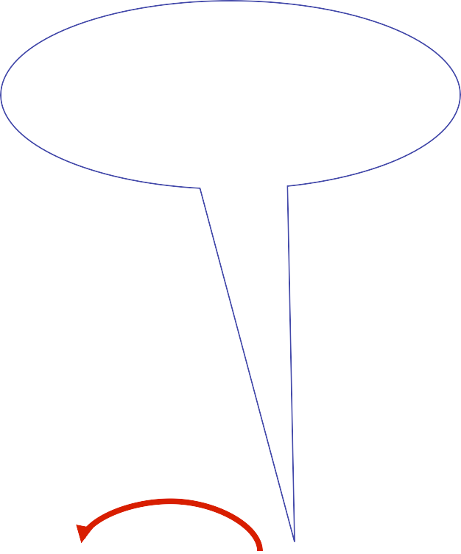
D sends vector to E
Iʼm 2 from C, 0 from D and 2 from E
Info at node | A | Distance B C |  | to | Node D E
A B C D E | 0 7 ∞ ∞ 1 | 7 0 1 ∞ 8 | ∞ 1 0 2 4 | ∞ ∞ 2 0 2 |  | 1 8 ∞ 2 0
B
1
C
7
A
8
2
1
E
2
D
D is 2 away, 2+2< ∞, so best path to C is 4

Slide 16


B sends vector to A
Iʼm 7 from A, 0 from B, 1 from C & 8 from E
Info at node | A | Distance B C |  | to | Node D E
A B C D E | 0 7 ∞ ∞ 1 | 7 0 1 ∞ 8 | 8 1 0 2 4 | ∞ ∞ 2 0 2 |  | 1 8 ∞ 2 0
B
1
C
7
A
8
2
1
E
2
D
B is 7 away, 1+7< ∞ so best path to C is 8

Slide 17

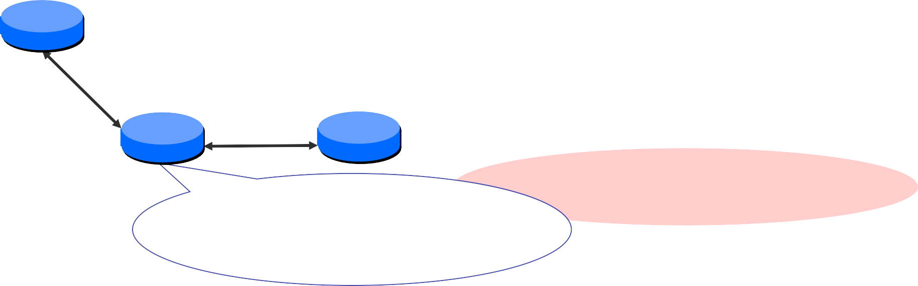
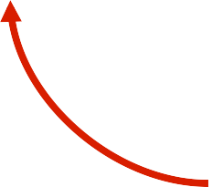
E sends vector to A
E is 1 away, 4+1<8
so C is 5 away, 1+2<
∞ so D is 3 away
Info at node | A | Distance B C |  | to | Node D E
A B C D E | 0 7 ∞ ∞ 1 | 7 0 1 ∞ 8 | 5 1 0 2 4 | 3 ∞ 2 0 2 |  | 1 8 ∞ 2 0
B
1
C
7
A
8
2
1
E
2
D
Iʼm 1 from A, 8 from B, 4 from C, 2 from D & 0 from E

Slide 18

…until Convergence
Info at node | A | Distance B C |  | to | Node D E
A B C D E | 0 6 5 3 1 | 6 0 1 3 5 | 5 1 0 2 4 | 3 3 2 0 2 |  | 1 5 4 2 0
B
1
C
7
A
8
2
1
E
2
D

Slide 19

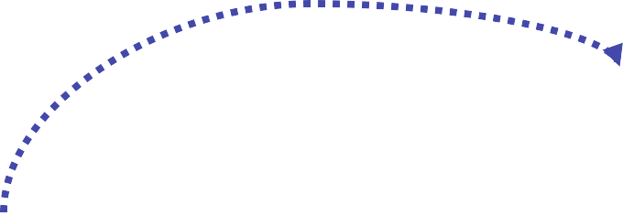
Node Bʼ' ‘s distance vectors
Dest | Next hop A E C
A C D E | 7 9 6 12 12 1 10 10 3 8 8 5
B
1
C
7
A
8
2
1
E
2
D

Slide 20

Handling Link Failure
A marks distance to E as ∞ , and tells B
E marks distance to A as ∞ , and tells B and D
B and D recompute routes and tell C, E and E
etc… until converge
Info at node | A | Distance B C |  | to | Node D | E
A B C D E | 0 7 8 10 12 | 7 0 1 3 5 | 8 1 0 2 4 | 10 3 2 0 2 |  | 12 5 4 2 0
B
1
C
7
A
8
2
1
E
2
D

Slide 21
RIP ( Routing Information Protocol)
included in BSD-UNIX distribution in 1982
distance vector algorithm
distance metric: # hops (max = 15 hops), each link has cost 1
DVs exchanged with neighbors every 30 sec in response message (aka advertisement)
each advertisement: list of up to 25 destination subnets (in IP addressing sense)
from router A to destination subnets:
u
v
subnet hops
u 1
v 2
w 2
x 3
y 3
z 2
A
B
w
x
z
C
D
y

Slide 22
RIP: example
z
w
x
y
A
D
B
C
routing table in router D
destination subnet next router # hops to dest
w A 2
y B 2
z B 7
x -- 1
…. …. ....

Slide 23
RIP: example
A-to-D advertisement
dest next hops
w - 1
x - 1
z C 4
…. … ...
z
w
x
y
A
D
B
C
routing table in router D
destination subnet next router # hops to dest
w A 2
y B 2
z B 7
x -- 1
…. …. ....
A
5

Slide 24
RIP: link failure, recovery
if no advertisement heard after 180 sec --> neighbor/link declared dead
routes via neighbor invalidated
new advertisements sent to neighbors
neighbors in turn send out new advertisements (if tables changed)
link failure info quickly (?) propagates to entire net
poison reverse used to prevent ping-pong loops (infinite distance = 16 hops)

Slide 25


RIP Problem: Count to Infinity
R₁
R₂
1. Initially, R₁ and R₂ both have a route to N with metric 1 and 2, respectively.
N
N 1 -
N 2 R₁
N 1 -
N 2 R₁
2. The link between R₁ and N fails.
x
N
N 1 -
N 2 R₁
N 1 -
N 2 R₁
3. Now R₁ removes its route to N, by setting its metric to 16 (infinity).
N
N 16
N 2 R₁
N 16
N 2 R₁
4. Now two things can happen: Either R₁ reports its route to R₂. Everything is fine.
N 16
N 16
N
N 16
N 16
N 16
N 16

Slide 26

RIP Problem: Count to Infinity
R₁
5. The other alternative is that R₂, which
R₂
N 2
N 2
still has a route to N, advertises it to R₁. Now things start to go wrong: packets to N are looped until their TTL expires!
N
Loop!
N 3 R₂
N 2 R₁
N 3 R₂
N 2 R₁
6. Eventually (~10-20s), R₁ sends an update to R₂. The cost to N increases, but the loop remains.
N 3
N 3
N
Loop!
N 3 R₂
N 4 R₁
N 3 R₂
N 4 R₁
7. Yet some time later, R₂ sends an
N 4
update to R₁.
N 4
...
13. Finally, the cost reaches infinity at 16, and N is unreachable. The loop is broken!
N
Loop!
N 5 R₂
N 4 R₁
N 5 R₂
N 4 R₁
N
N 16
N 16
N 16
N 16

Slide 27
Solution1: Triggered Update
Send out update immediately
R₁
R₂
N 16
R Immediately announces the broken
N 16
1
N
link when it happens.
N 16
N 16
N 16
N 16
Triggered updates can cause excessive load on networks with limited capacity or networks with many routers on them.

Slide 28
Solution 2: Split Horizon
Do not propagate information about a route over the same interface from which the route arrived.
Split horizon only prevents loops between adjacent routers
R₁ R₂
R₂, does not announce the route to N to R₁ since that is where it came from.
N
N 16
N 2 R₁
N 16
N 2 R₁
Eventually, R₁ reports its route to R₂ and everything is fine.
N 16
N 16
N
N 16
N 16
N 16
N 16

Slide 29
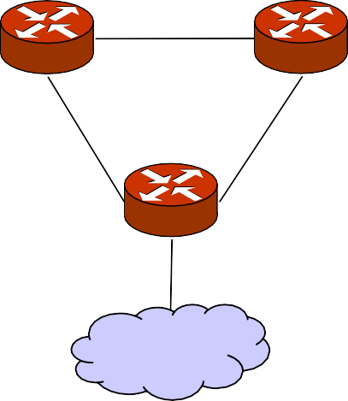
Split Horizon Does Not Solve All Cases
R₂ R₃
R₁
X
N
R1 reports to R2 that N is unreachable
R2 believes that D is reachable through R3
R2 reports this to R1, who believes that N can be reached through R2....
Somewhat depending on timing.....

Slide 30
Solution 3: Poison Reverse
Advertise reverse routes with a metric of 16 (i.e., unreachable).
Somewhat more aggressive variant of split horizon
– It handles some more error cases than split horizon
R₁
R₂
N 16
R always announces an unreachable
N 16
2
N
route to N to R₁.
N 16
N 2 R₁
N 16
N 2 R₁
Eventually, R₁ reports its route to R₂ and everything is fine.
Limitation: Only works for “loop”s of size 2
N 16
N 16
N
N 16
N 16
N 16
N 16

Slide 31

Solution 4: Hold Down
When a route is removed, no update of this route is accepted for some period of time (hold-down time)- to give everyone a chance to remove the route.
R₁ R₂
R₁ ignores updates to N from R₂ for some period of time.
N 2
N 2
N
N 16
N 2 R₁
N 16
N 2 R₁
N 16
Eventually, R₁ sends the update to R₂.
Limitation: Delays convergence
N 16
N
N 16
N 16
N 16
N 16

Slide 32
Disadvantages with RIP
Slow convergence
Changes propagate slowly
Each neighbor only speaks ~every 30 seconds; information propagation time over several hops is long
Instability
After a router or link failure RIP takes minutes to stabilize.
Hops count may not be the best indication for which is the best route.
The maximum useful metric value is 15
Network diameter must be less than or equal to 15.
RIP uses lots of bandwidth
It sends the whole routing table in updates.

Slide 33
Why Use RIP?
After all these problems you might ask this question
Answer
Because RIP is generally available
It is simple to configure.

